Slide 1
Tableau Dashboards
Feb 2022

Slide 2
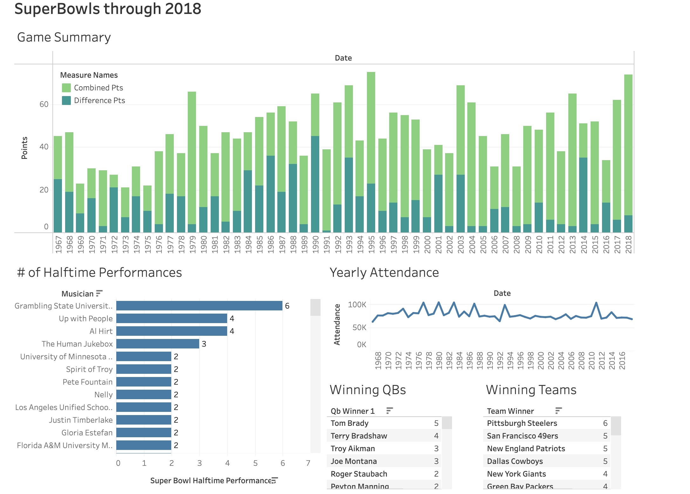

Slide 3
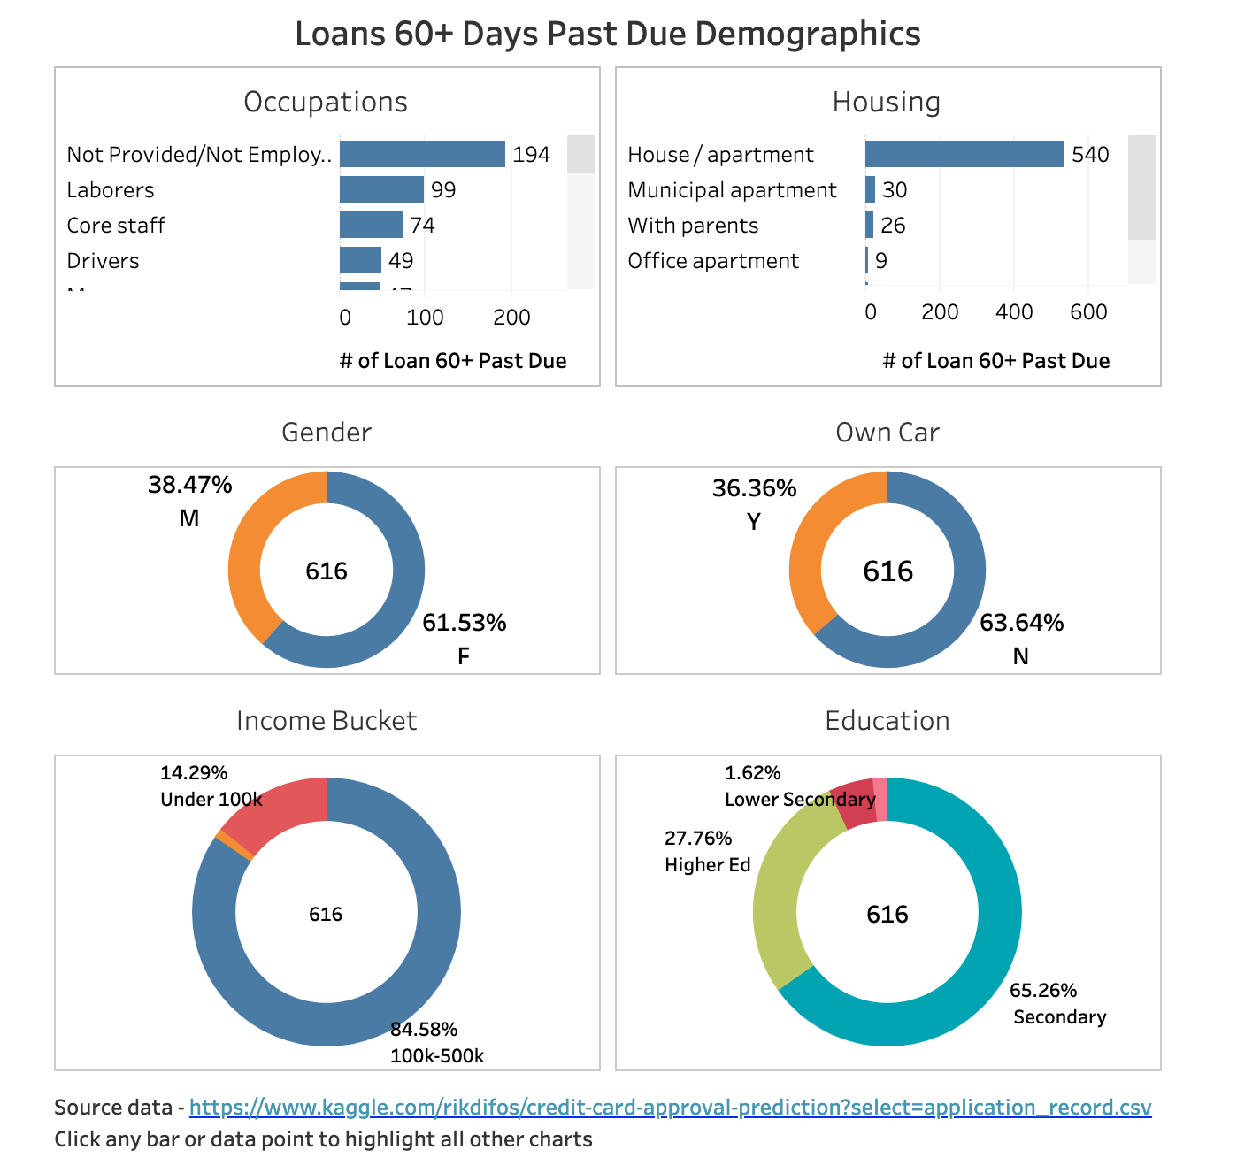

Slide 4
